Slide 2
Live Scorer
SCOREBOARD
K-CIRCLE QUIZ CLUB
Team 1
0
-5
5
10
Team 2
0
-5
5
10
Click buttons in order to initialize scoreboard:
Team 3
0
-5
5
10
Reset Scores
Team 4
0
-5
5
10
Sync Team Names
Team 5
0
-5
5
10
Validate Scoreboard
Team 6
0
-5
5
10
Team 7
0
-5
5
10
Check Duplicates
Team 8
0
-5
5
10
Developed by Revanth T (revanthturlapati@gmail.com) for K-Circle Quiz Club (kckcircle@gmail.com).
Team 9
0
-5
5
10
Team 10
0
-5
5
10

Slide 3
SCOREBOARD
0
0
Team 1
Team 6
0
0
Team 2
Team 7
0
0
Team 3
Team 8
0
0
Team 4
Team 9
0
0
Team 5
Team 10

Slide 4
Instructions
You need to enable macros for this file to run. Do so by closing the file, right-clicking on it in File Explorer, opening Properties and clicking the Unblock checkbox. After opening the file and accepting everything under the taskbar, it should be working.
Download the free font Poppins for the best visual experience. Download ZIP file, extract all, right-click all files, and install.
Works best on a Windows laptop in Powerpoint. MacOS requires some slight changes to the code. Doesn’t work on mobile, or Slides.
Any problem, or feedback? Email kcqc.alerts@gmail.com

Slide 5
Instructions
For the Live Scorer to work, Slide 2 needs to stay exactly the same. Do not make any changes to it.
You can copy the template slides and use them for your questions, or add new slides. Copy the scoreboard from Slide 2 and paste into your answer slides if you’re doing the latter.
DO NOT click the Validate Scoreboard button until you finish your quiz and are ready to run it. If you do that, pasting the scoreboard into any slide breaks the presentation. The buttons in Slide 2 are for the slideshow. Press them before running the quiz in the order – Reset Scores > Sync Team Names > Validate Scoreboard > Check Duplicates

Slide 6
Instructions
The scores are saved even if you end the slideshow. The only way to lose the scores is to hit the reset button. If you want to reset scores after every round, every question, etc. just copy the Reset button from Slide 2 and paste it wherever needed.
You can change the team names in the scoreboard. To do so, make the changes to the team names in Slide 2, and in Slideshow mode, click the SYNC TEAM NAMES button to update across the entire presentation.

Slide 7
Instructions
You’re good to go!
Delete the instructions and start building your quiz.
Keep in mind the Live Scorer WILL NOT RUN if
    You have not enabled macros by right-clicking the .pptm file in File Explorer and clicking Properties > Unblock
    Slide 2 is missing. Keep the Slide 2 of this presentation as Slide 2 every time you use the template. If the slide missing or isn’t the second slide, the scorer will not work.

Slide 8
Appendix 1
The Live Scorer needs a group named Scoreboard on every slide, and cannot run without the same. The Validate button adds a hidden Scoreboard group to every slide that does not have it. Adding the scoreboard into a slide after clicking Validate means you have two groups, which breaks the scoreboard.
For existing slides: The only change you need to make is that you cannot add the scoreboard to your existing slides anymore, as there would be 2 scoreboards in a slide. Open up Selection Pane (Editing > Select > Selection Pane) and instead, unhide the existing Scoreboard.
For new slides: New slides don’t have the Scoreboard group, so you can work with them as usual.
Essentially, make sure the number of Scoreboard groups in a slide is always 0 or 1.

Slide 9
Template Slides follow

Slide 11
SCOREBOARD
K-CIRCLE QUIZ CLUB
Team 1
0
-5
5
10
Team 2
0
-5
5
10
Team 3
0
-5
5
10
Team 4
0
-5
5
10
Team 5
0
-5
5
10
Team 6
0
-5
5
10
Team 7
0
-5
5
10
Team 8
0
-5
5
10
Team 9
0
-5
5
10
Team 10
0
-5
5
10

Slide 13
SCOREBOARD
K-CIRCLE QUIZ CLUB
Team 1
0
-5
5
10
Team 2
0
-5
5
10
Team 3
0
-5
5
10
Team 4
0
-5
5
10
Team 5
0
-5
5
10
Team 6
0
-5
5
10
Team 7
0
-5
5
10
Team 8
0
-5
5
10
Team 9
0
-5
5
10
Team 10
0
-5
5
10

Slide 16
SCOREBOARD
K-CIRCLE QUIZ CLUB
Team 1
0
-5
5
10
Team 2
0
-5
5
10
Team 3
0
-5
5
10
Team 4
0
-5
5
10
Team 5
0
-5
5
10
Team 6
0
-5
5
10
Team 7
0
-5
5
10
Team 8
0
-5
5
10
Team 9
0
-5
5
10
Team 10
0
-5
5
10

Slide 20
SCOREBOARD
0
0
Team 1
Team 6
0
0
Team 2
Team 7
0
0
Team 3
Team 8
0
0
Team 4
Team 9
0
0
Team 5
Team 10

Slide 22
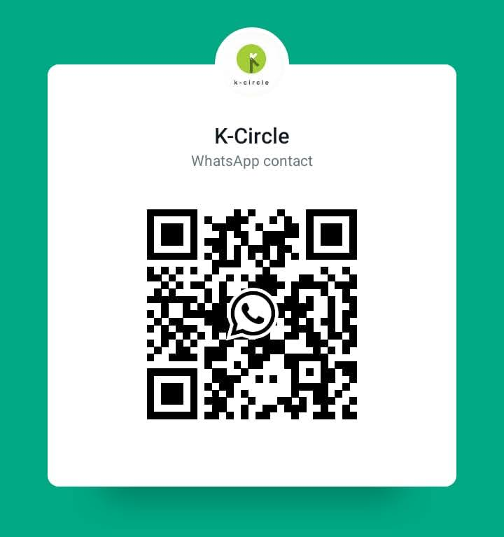

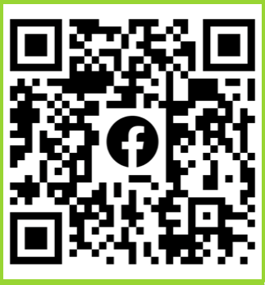
K-Circle on Social Media

